Slide 1
Digital Portfolio
STUDENT NAME: Rithanya C
REGISTER NO AND NMID: 2428B0339 And 3B46AC6318A96D393C04F8883075D6A5
DEPARTMENT: B Sc Computer Science With Data Analysis
COLLEGE: KPR College Arts Science And Research / Bharathiar University

Slide 2
Digital Portfolio for Showcasing Community & College Engagement

Slide 3


AGENDA
Problem Statement
Project Overview
End Users
Tools and Technologies
Portfolio design and Layout
Features and Functionality
Results and Screenshots
Conclusion
Github Link
3/21/2024 Annual Review

Slide 4

PROBLEM STATEMENT
In today’s digital age, students’ contributions beyond academics—such as community service, volunteering, and active participation in college activities—are often overlooked due to a lack of structured representation. Traditional resumes fail to highlight these crucial aspects effectively. There is a need for a platform that can systematically showcase a student’s involvement in community initiatives and college activities in an engaging, professional, and accessible manner.

Slide 5

PROJECT OVERVIEW
This project focuses on creating a digital portfolio that highlights an individual’s contributions to both community service and college involvement. The portfolio presents sections dedicated to community work, college activities, and notable achievements, allowing users to view the impact made through volunteering, leadership, and participation. The portfolio is designed using modern web technologies, ensuring that it is visually appealing, responsive, and easy to navigate.

Slide 6

End Users Students – to showcase their non-academic contributions and leadership experiences. Recruiters / Employers – to evaluate a candidate’s soft skills, leadership, and teamwork abilities beyond academics. College Authorities – to assess student involvement and encourage participation in community/college activities. Community Organizations – to identify active volunteers for future initiatives.

Slide 7

TOOLS AND TECHNIQUES
HTML5 – for structuring the portfolio content.
CSS3 – for styling, layout, and responsiveness.
JavaScript (ES6) – for interactivity (e.g., scroll-to-top button, smooth navigation).
GitHub Pages – for hosting and sharing the portfolio online.

Slide 8
POTFOLIO DESIGN AND LAYOUT
Header Section – Includes the project title and navigation bar for quick access to sections.
Community Work Section – Highlights volunteer initiatives, NGO participation, and awareness drives.
College Activities Section – Showcases roles in student councils, technical clubs, and event organization.
Achievements Section – Displays awards, recognitions, and accomplishments.
Footer Section – Provides copyright details.
Interactive Features – Scroll-to-top button and hover effects for engagement.
8

Slide 9
FEATURES AND FUNCTIONALITY
Responsive design for viewing on mobile, tablet, and desktop devices.
Navigation links for smooth scrolling to sections.Interactive cards with hover animations for highlighting activities.
Scroll-to-top button for better user experience.Structured presentation of contributions (community, college, achievements).
Easy customization for future updates.

Slide 10
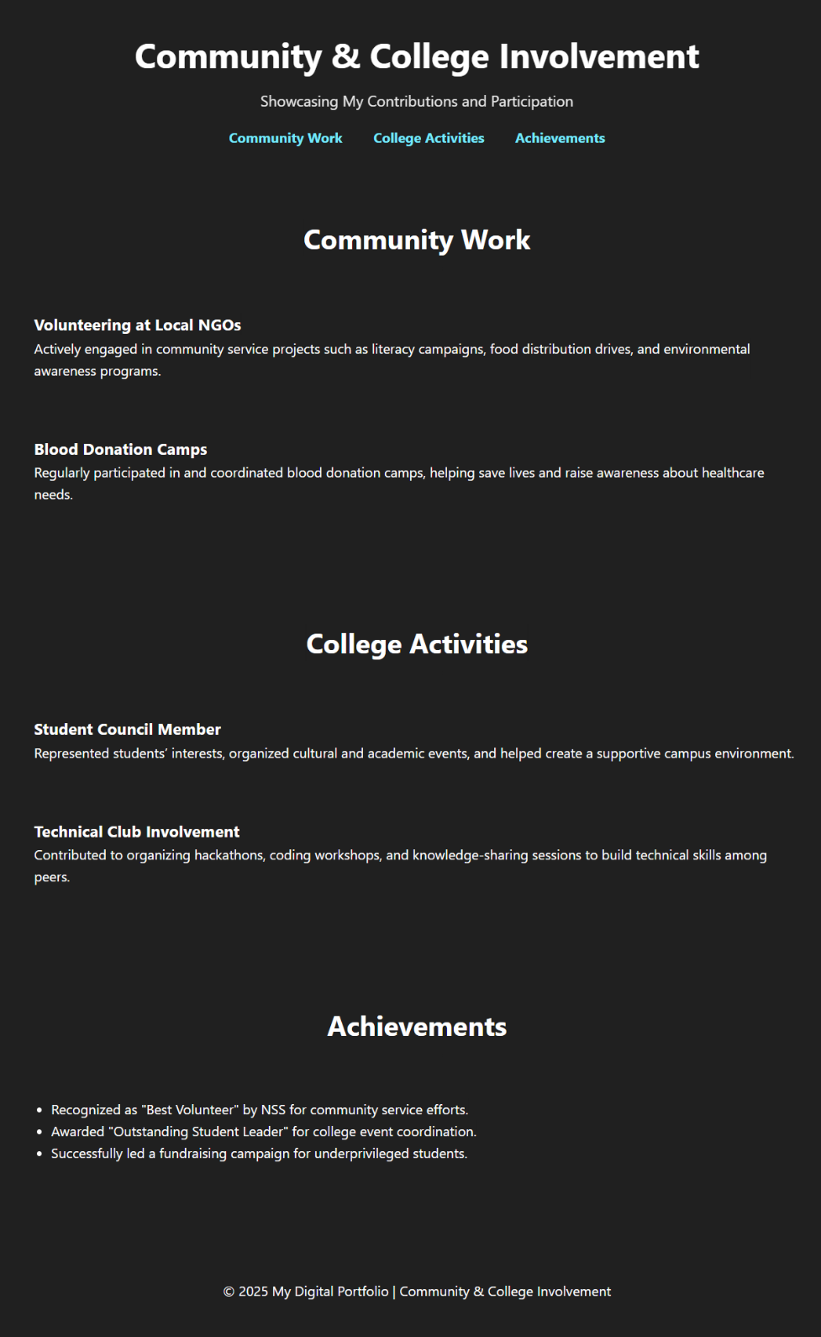

RESULTS AND SCREENSHOTS
The digital portfolio successfully displays community involvement and college participation in a structured format.Interactive features improve navigation and make the portfolio engaging.Students can now present both academic and non-academic achievements to recruiters and institutions
.
3/21/2024 Annual Review
10

Slide 11
CONCLUSION
The project demonstrates how a digital portfolio can effectively highlight a student’s community engagement and college activities. By integrating design and interactivity, the portfolio provides a professional platform to showcase leadership, teamwork, and social responsibility. This tool bridges the gap between academic performance and holistic student development, offering a modern approach to personal branding.
11

Slide 12
Github Link
https://github.com/Rithanya724/RithanyaC/actions/runs/17382023779/job/49341487414

